Slide 1
Tables, Lists, Semantic markup and new Elements
By Volodymyr Lukashevych

Slide 2
AGENDA
Tables in HTML5
Lists in HTML5
Semantic markup
New Elements in HTML5

Slide 3
Defining an HTML Table
An HTML table is defined with the <table> tag.
Each table row is defined with the <tr> tag. A table header is defined with the <th> tag. By default, table headings are bold and centered. A table data/cell is defined with the <td> tag.

Slide 4

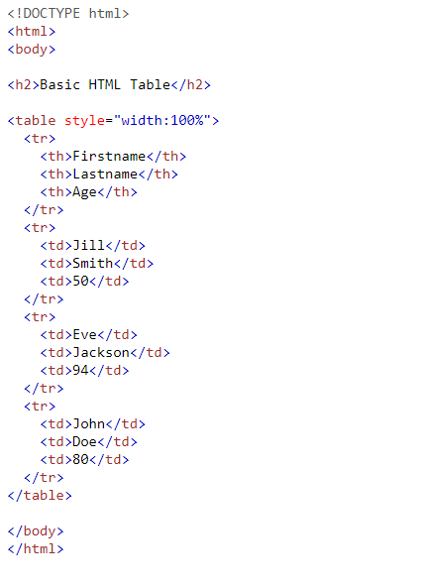

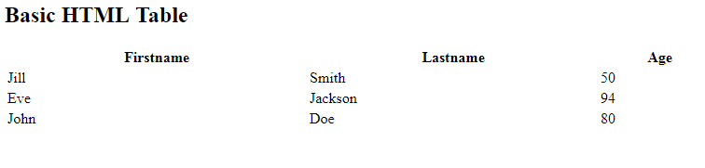

Slide 5
HTML Table - Adding a Border
If you do not specify a border for the table, it will be displayed without borders.
A border is set using the CSS border property.

Slide 6

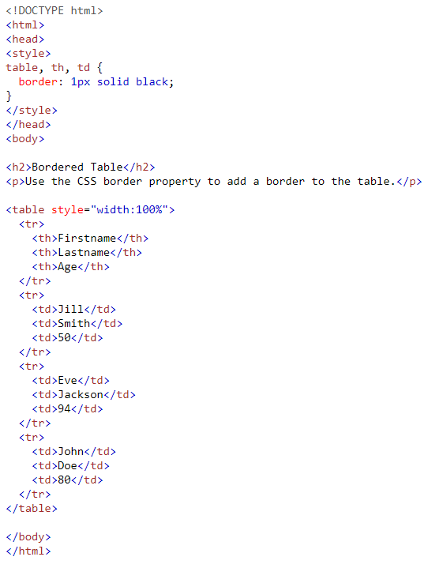

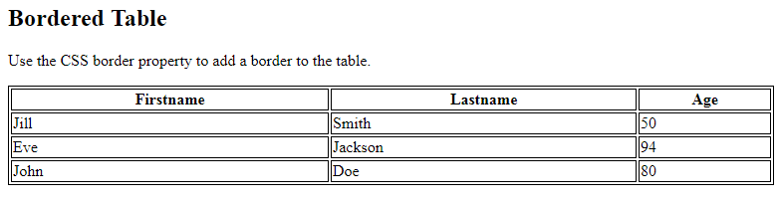

Slide 7
HTML Table - Adding Cell Padding
Cell padding specifies the space between the cell content and its borders.
If you do not specify a padding, the table cells will be displayed without padding.
To set the padding, use the CSS padding property.

Slide 8

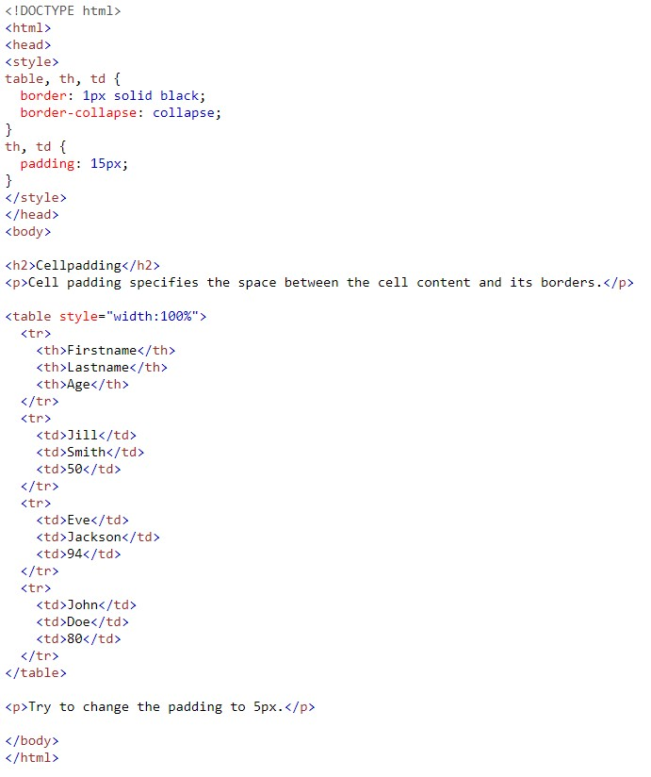

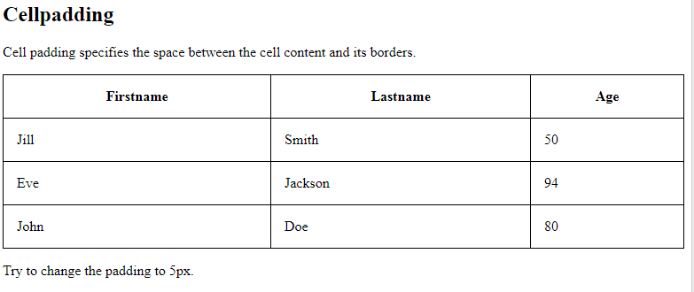

Slide 9
HTML Table - Align Headings
By default, table headings are bold and centered.
To align the table headings, use the CSS text-align property.

Slide 10

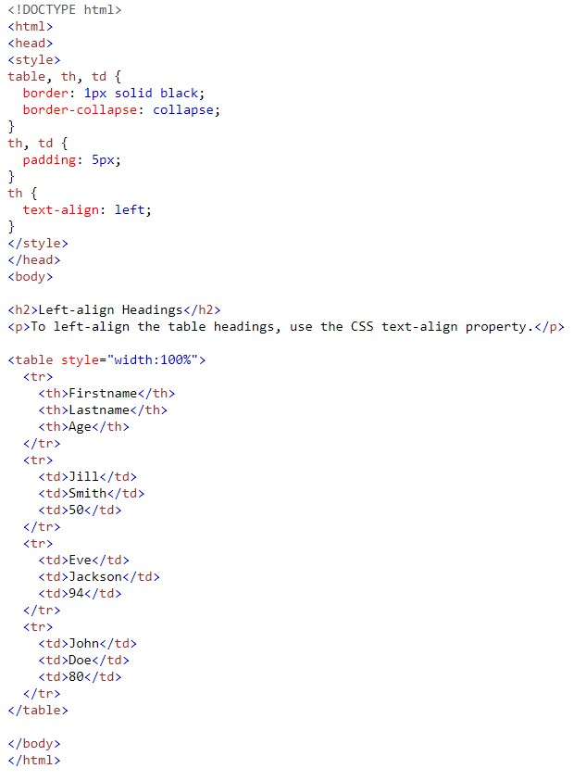

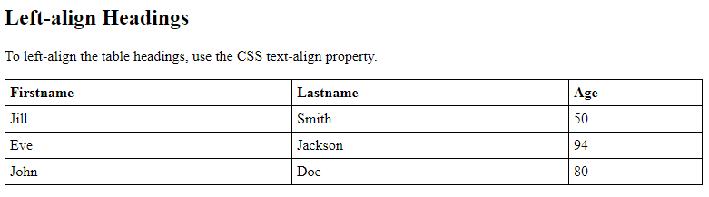

Slide 11
HTML Table - Cells that Span Many Columns/Rows
To make a cell span more than one column, use the colspan attribute.
To make a cell span more than one row, use the rowspan attribute.

Slide 12

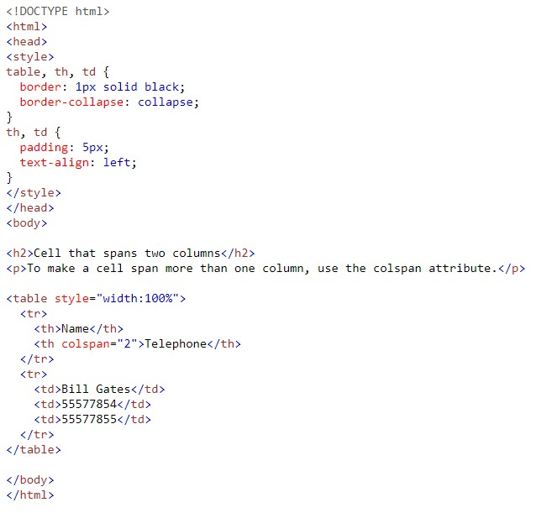

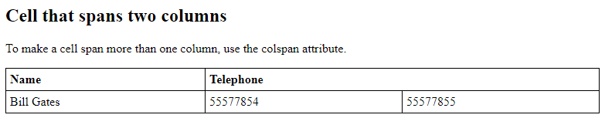

Slide 13
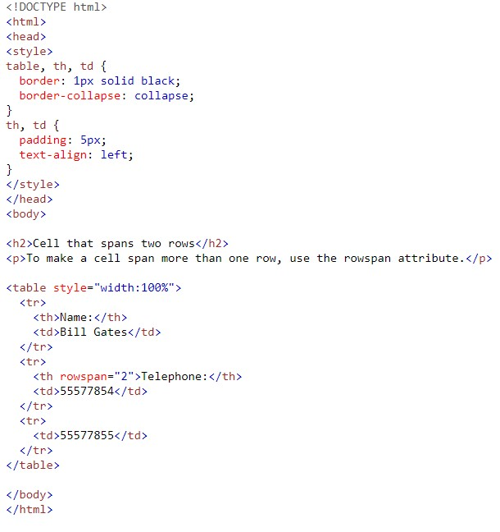

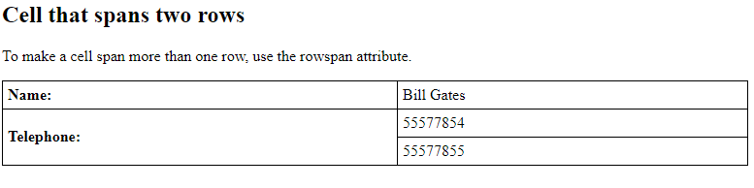

Slide 14
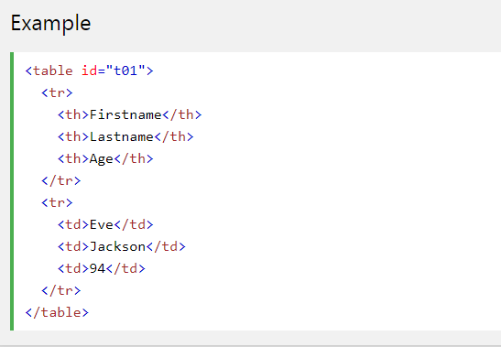

A Special Style for One Table
To define a special style for a special table, add an id or an class attribute to the table:

Slide 15

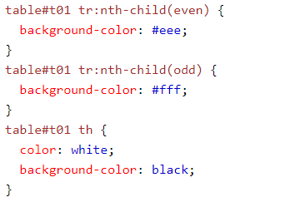

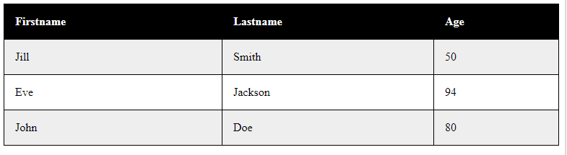
Now you can define a special style for this table

Slide 16
HTML - Lists
HTML offers web authors three ways for specifying lists of information. All lists must contain one or more list elements. Lists may contain −
<ul> − An unordered list. This will list items using plain bullets.
<ol> − An ordered list. This will use different schemes of numbers to list your items.
<dl> − A definition list. This arranges your items in the same way as they are arranged in a dictionary.

Slide 17
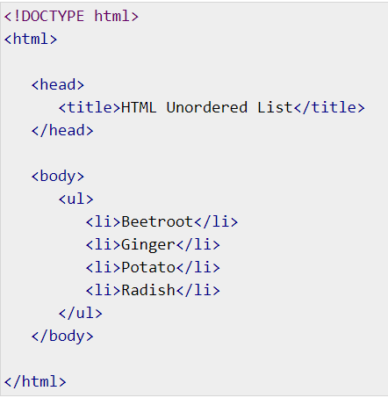
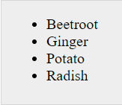
HTML Unordered Lists
An unordered list is a collection of related items that have no special order or sequence. This list is created by using HTML <ul> tag. Each item in the list is marked with a bullet.

Slide 18

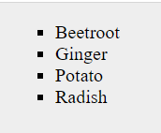
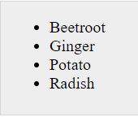
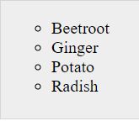
The type Attribute
You can use type attribute for <ul> tag to specify the type of bullet you like. By default, it is a disc. Following are the possible options −

Slide 19
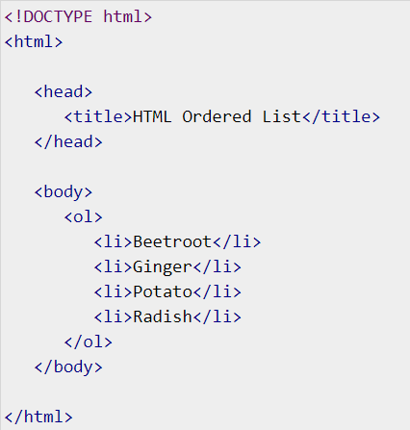
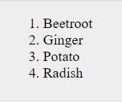
HTML Ordered Lists
If you are required to put your items in a numbered list instead of bulleted, then HTML ordered list will be used. This list is created by using <ol> tag. The numbering starts at one and is incremented by one for each successive ordered list element tagged with <li>.

Slide 20
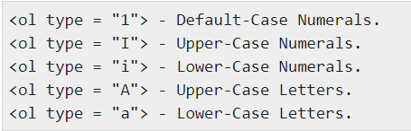
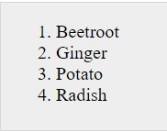
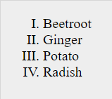
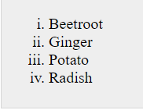
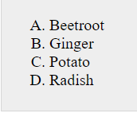
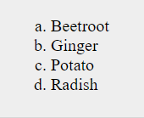
The type Attribute
You can use type attribute for <ol> tag to specify the type of numbering you like. By default, it is a number. Following are the possible options −

Slide 21
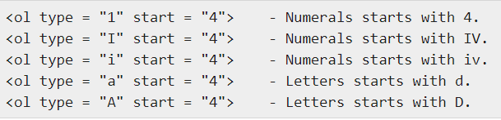
The start Attribute
You can use start attribute for <ol> tag to specify the starting point of numbering you need. Following are the possible options −

Slide 22
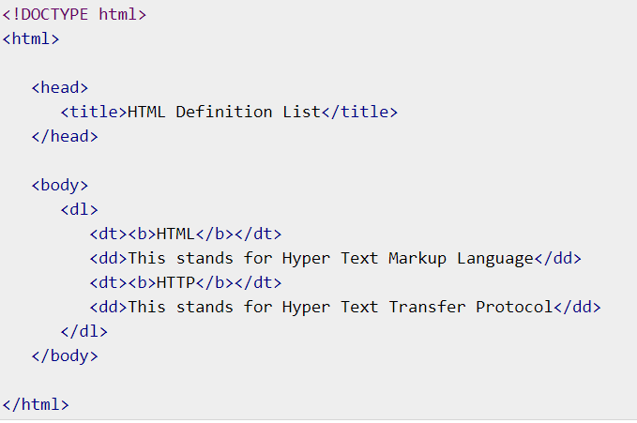
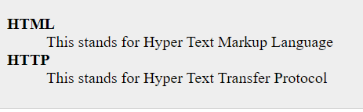
HTML Definition Lists
HTML and XHTML supports a list style which is called definition lists where entries are listed like in a dictionary or encyclopedia. The definition list is the ideal way to present a glossary, list of terms, or other name/value list.
Definition List makes use of following three tags.
<dl> − Defines the start of the list
<dt> − A term
<dd> − Term definition
</dl> − Defines the end of the list

Slide 23
Semantic HTML
Semantic HTML or semantic markup is HTML that introduces meaning to the web page rather than just presentation. For example, a <p> tag indicates that the enclosed text is a paragraph. This is both semantic and presentational because people know what paragraphs are, and browsers know how to display them.

Slide 24
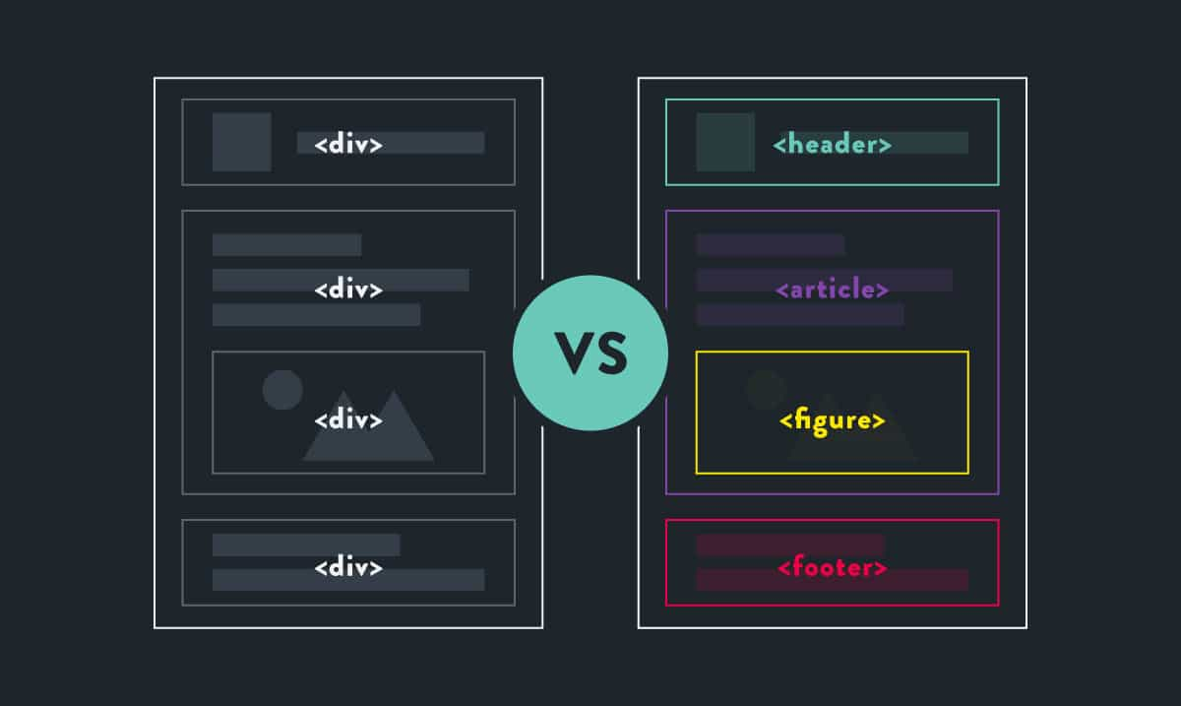
Why You Should Care About Semantics
The benefit of writing semantic HTML stems from what should be the driving goal of any web page: the desire to communicate. By adding semantic tags to your document, you provide additional information about that document, which aids in communication. Specifically, semantic tags make it clear to the browser what the meaning of a page and its content is. That clarity is also communicated with search engines, ensuring that the right pages are delivered for the right queries.

Slide 25
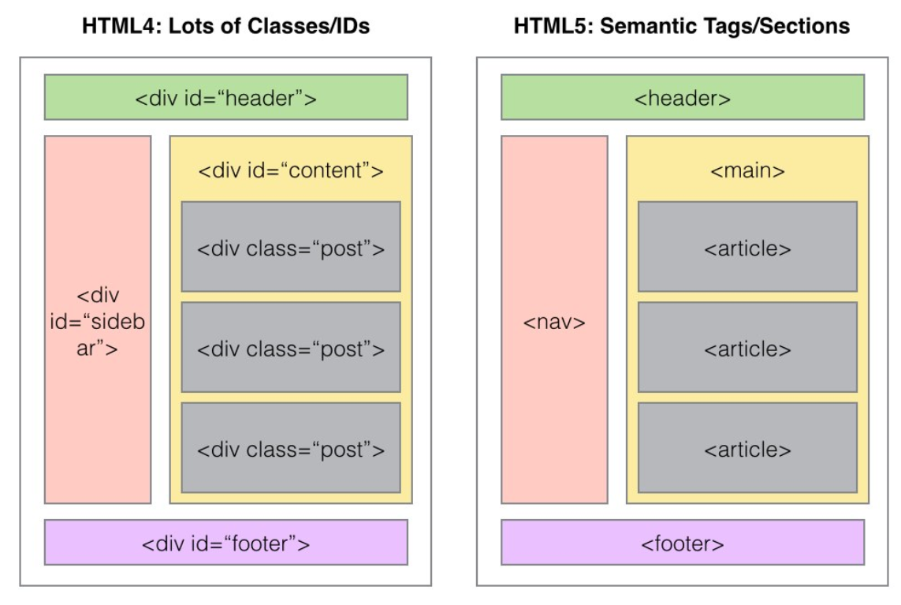
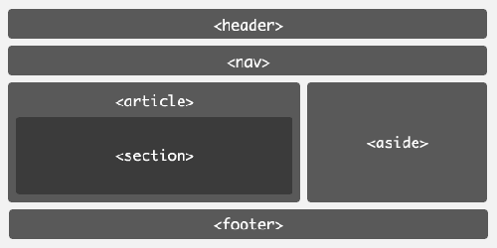
Semantic HTML tags provide information about the contents of those tags that goes beyond just how they look on a page. Text that is enclosed in the <code> tag is immediately recognized by the browser as some type of coding language. Instead of trying to render that code, the browser understands that you are using that text as an example of the code for the purposes of an article or online tutorial.

Slide 26
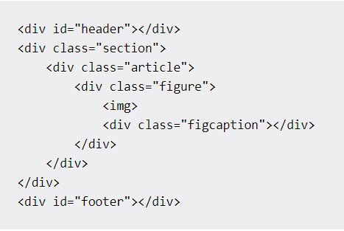
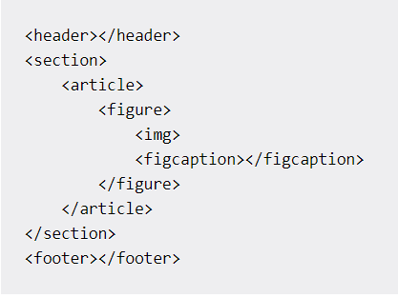
It has greater accessibility. You are not the only one that finds semantic elements easier to understand. Search engines and assistive technologies (like screen readers for users with a sight impairment) are also able to better understand the context and content of your website, meaning a better experience for your users.

Slide 27
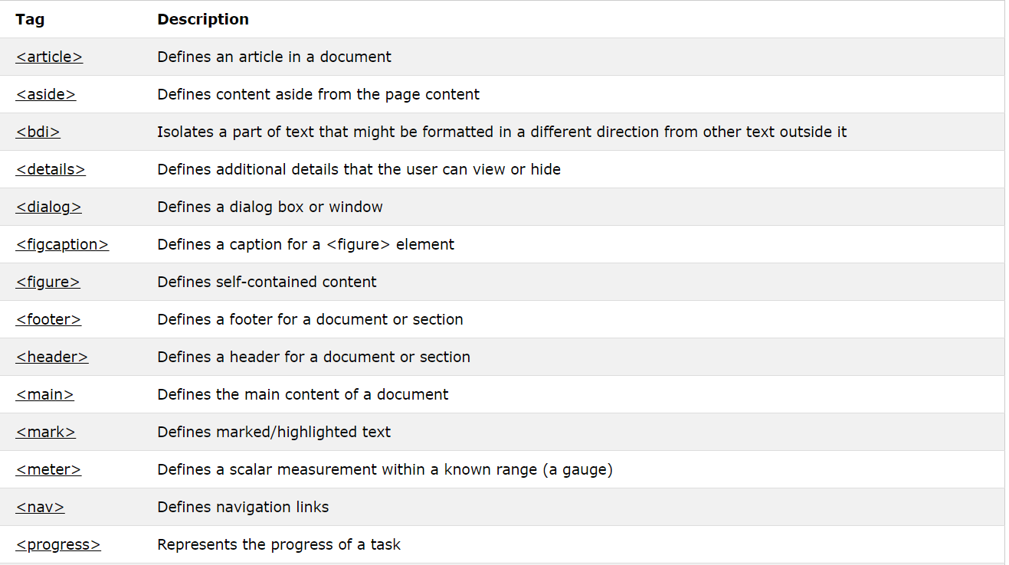
New Semantic/Structural Elements

Slide 28
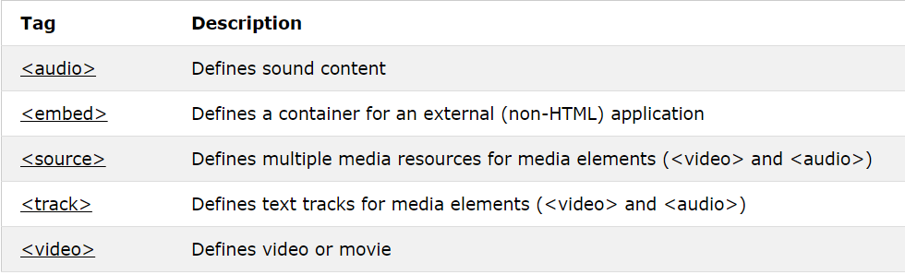
New Media Elements

Slide 29


